Slide 1
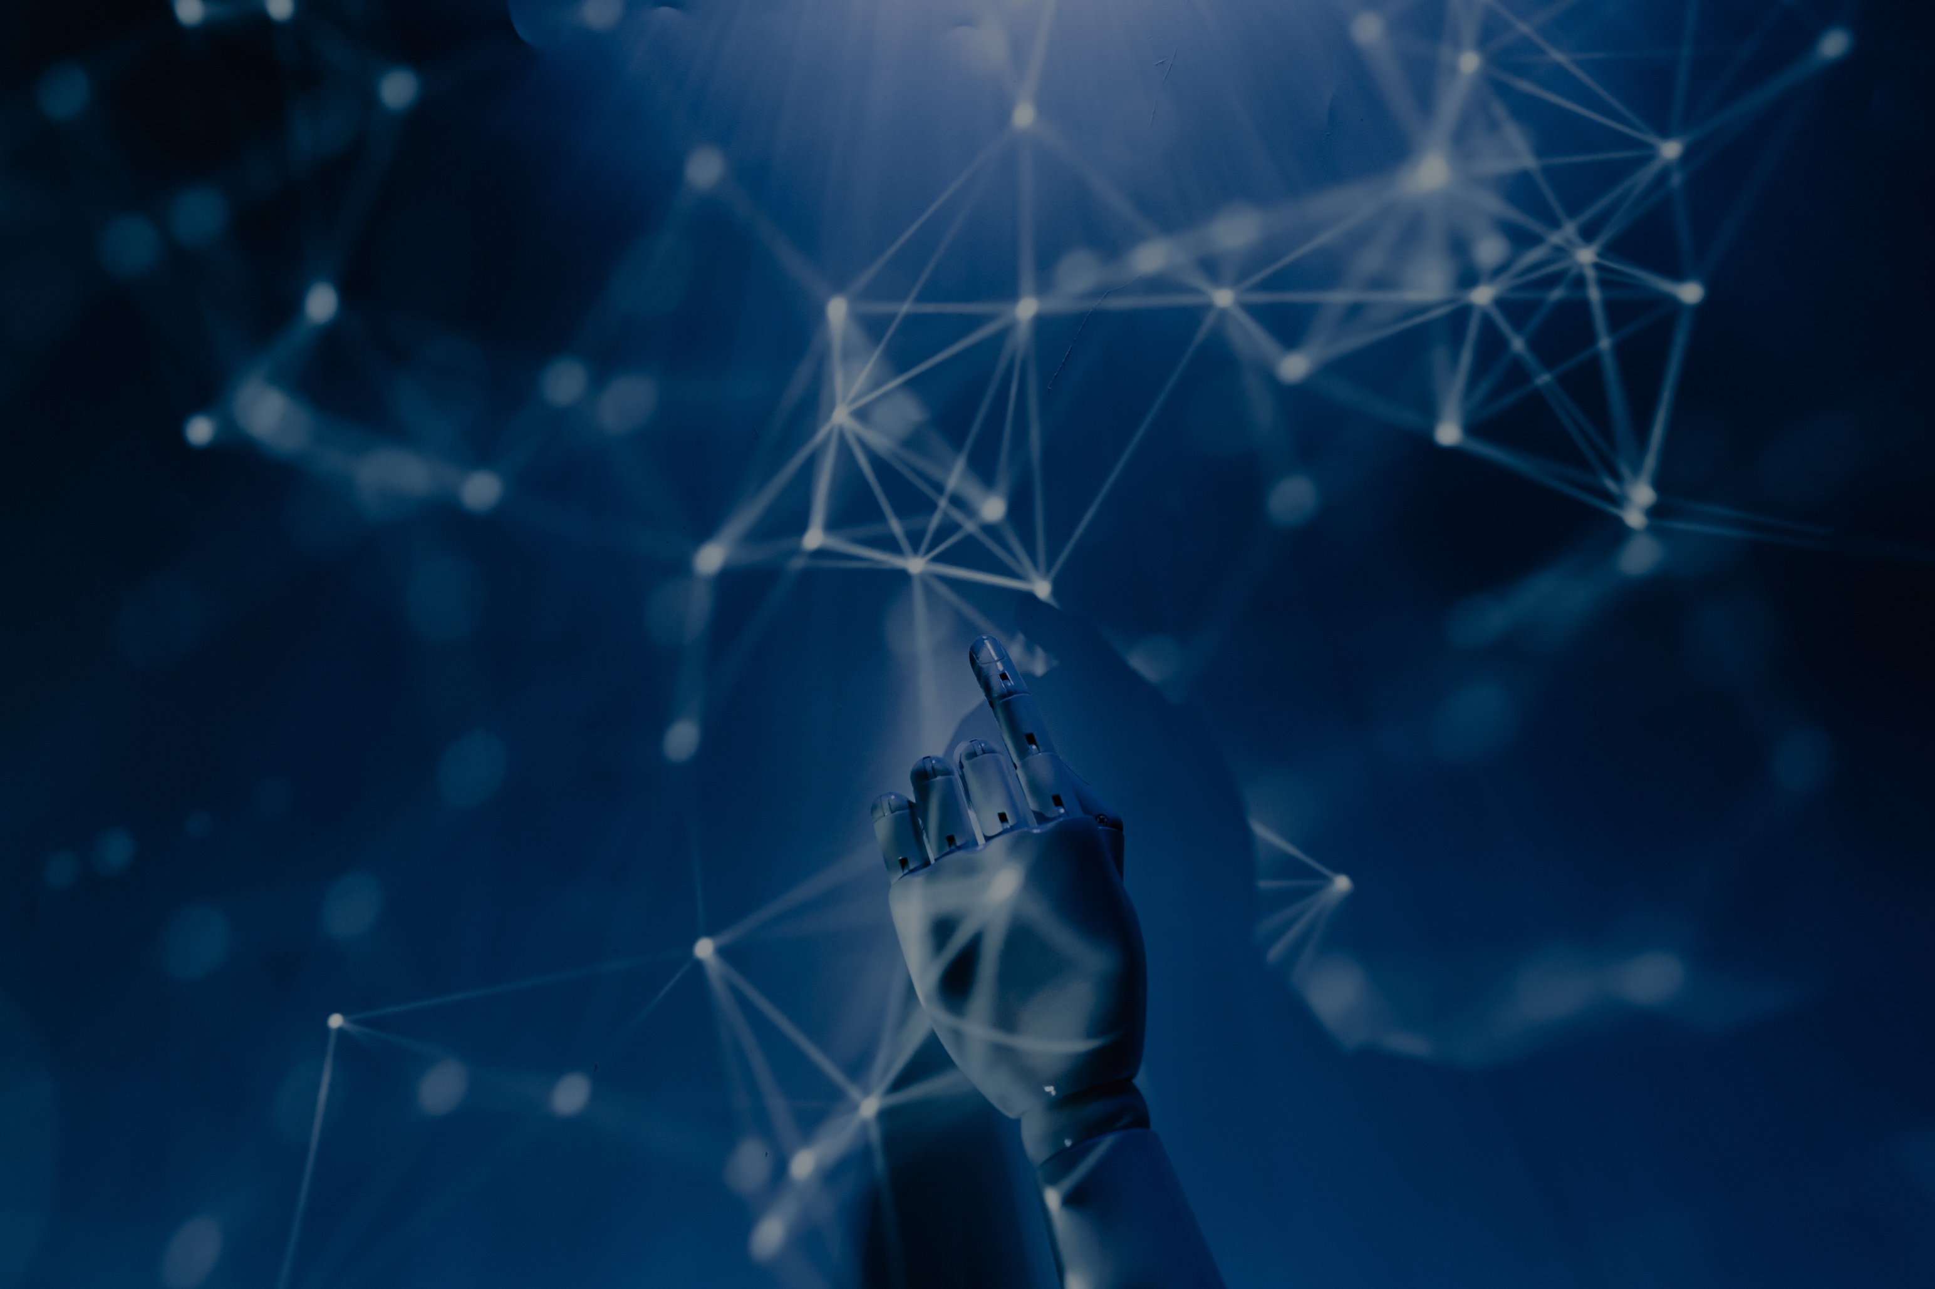
Unlocking Creativity: Generative AI
-Shardul Chavan

Slide 2
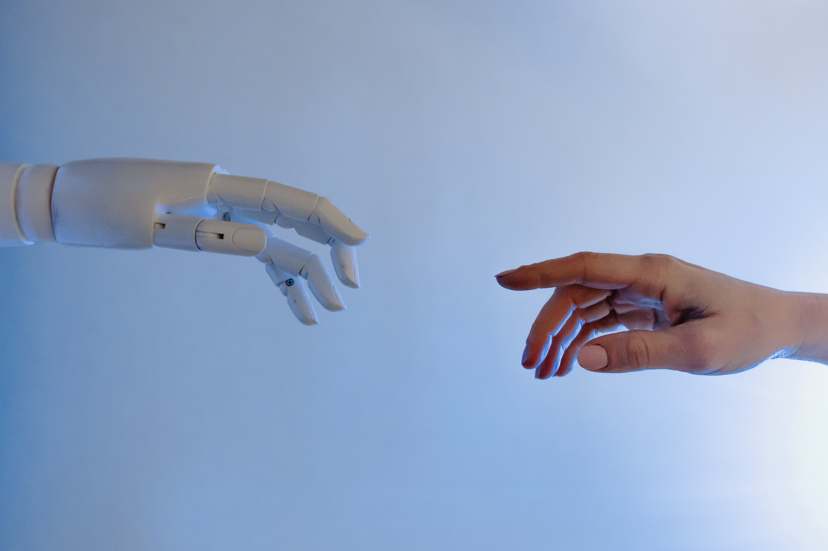
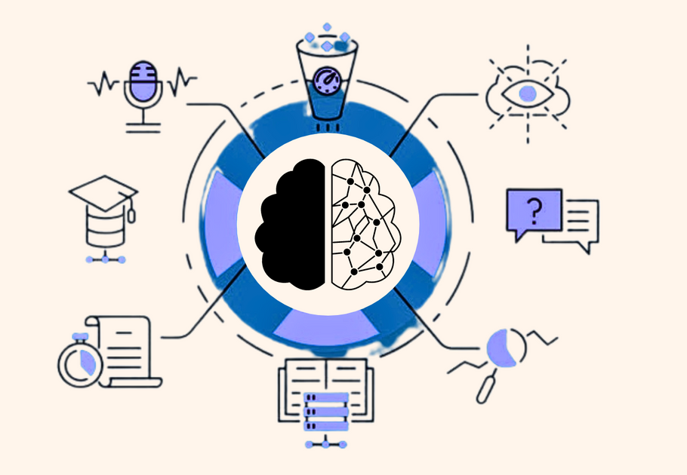
Generative AI is a cutting-edge field of artificial intelligence
It's all about AI systems that can create new, original content.
Introduction to Generative AI
Generative AI is a cutting-edge field of artificial intelligence.
It's all about AI systems that can create new, original content.
Imagine machines that can paint, write, and compose music!

Slide 3
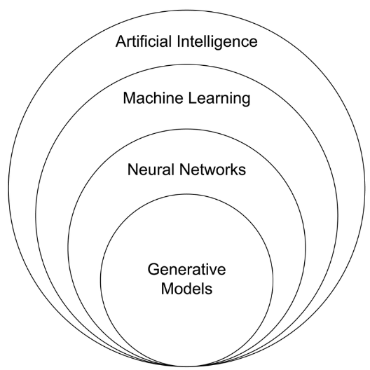
Generative AI is a cutting-edge field of artificial intelligence
It's all about AI systems that can create new, original content.
Creativity at the Core
Generative AI learns from vast datasets of human creations.
It identifies patterns, styles, and structures in the data.
Then, it generates content that's remarkably human-like.

Slide 4
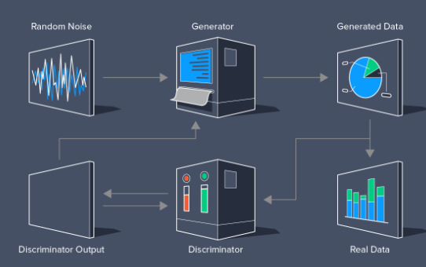
Generative AI is a cutting-edge field of artificial intelligence
It's all about AI systems that can create new, original content.
Under the Hood: How It Works
Generative AI uses neural networks and algorithms.
It's inspired by how our brains process information.
Generative Adversarial Networks (GANs) are star players.

Slide 5
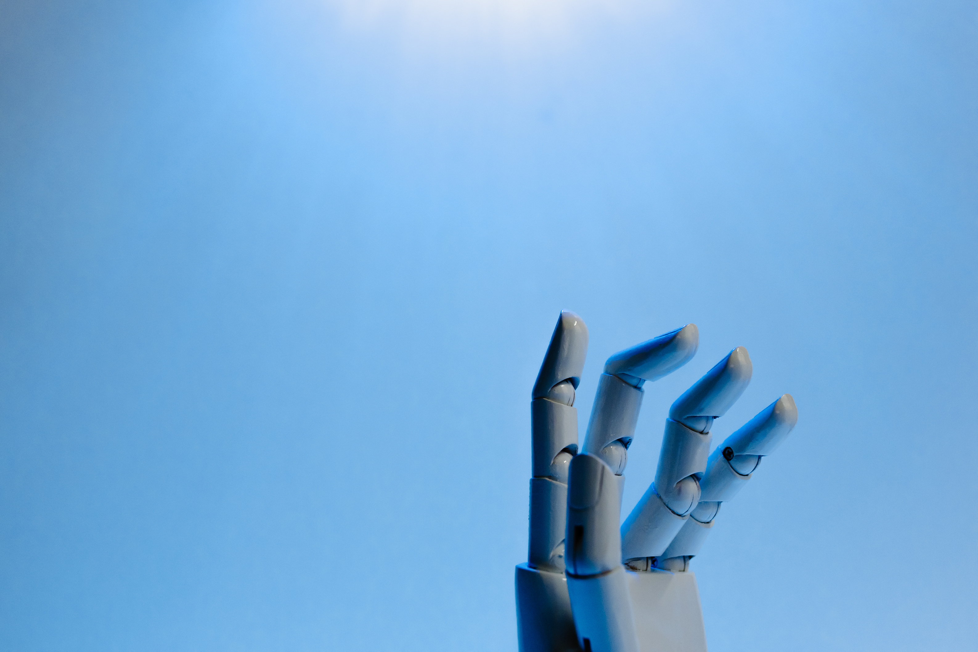
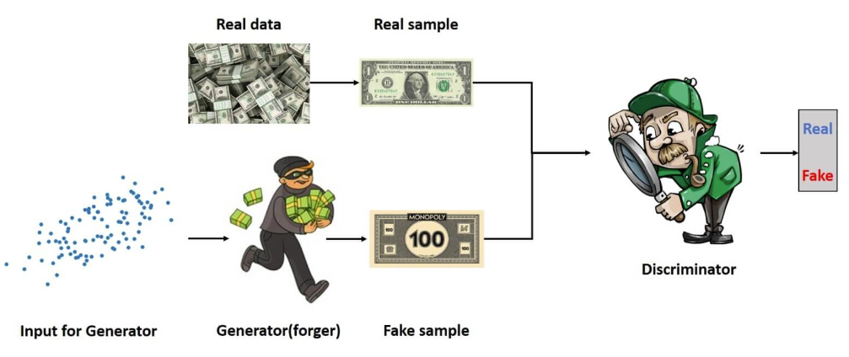
Generative Adversarial Networks (GANs) in Action
Imagine GANs as two teams: forger and police.
The forger generates content, and the police evaluate it.
They compete to improve, creating stunning results.

Slide 6
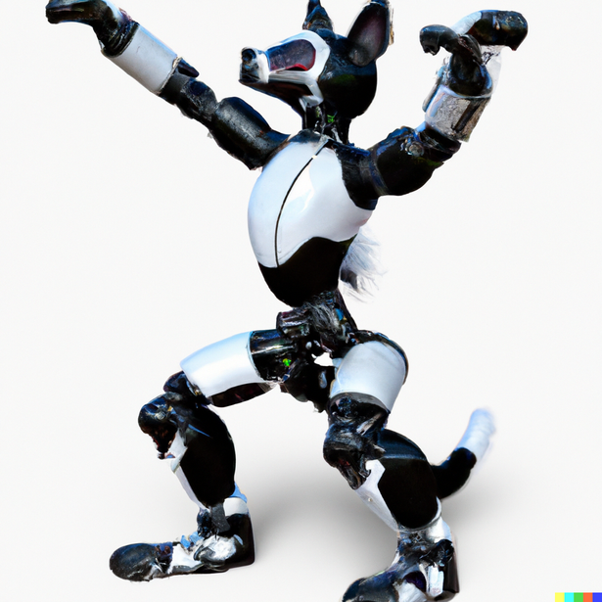
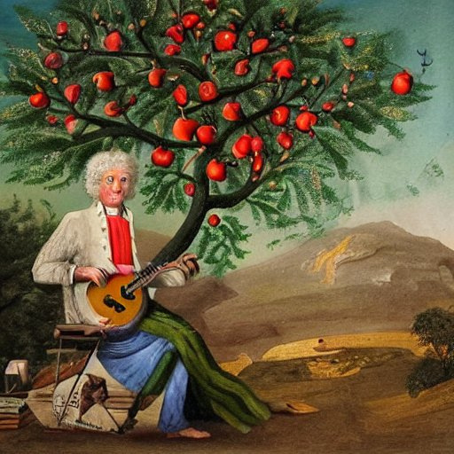
Real-World Applications
Generative AI is transforming industries.
From art and fashion to gaming and medicine.
It's changing how we create and innovate.

Slide 7
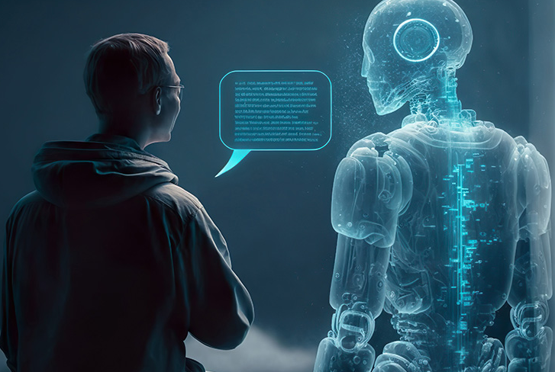
Real-World Applications
Quality and realism can be a challenge.
Bias and ethics need careful consideration.
But the possibilities are vast and inspiring.

Slide 8
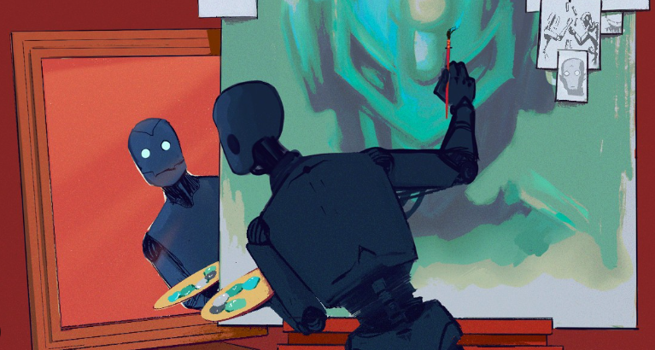
The Future of Creativity
Generative AI is reshaping the creative landscape.
It's a glimpse into the limitless potential of AI.
Get ready to unlock new realms of creativity!

Slide 9

Questions?
Thank you for exploring Generative AI with us.
Any questions or thoughts?"

